Slide 1


SPOTIFY PLAYLIST EXTENSION WITH PATTERN MINING AND CLUSTERING
Automatic Playlist Continuation Using Association Rules, Clustering, and Hybrid Recommendation Models
Adarsh Singh
Fall 2025
CSCI 6443: Data Mining
Project Repo: spotify-playlist-mining

Slide 2
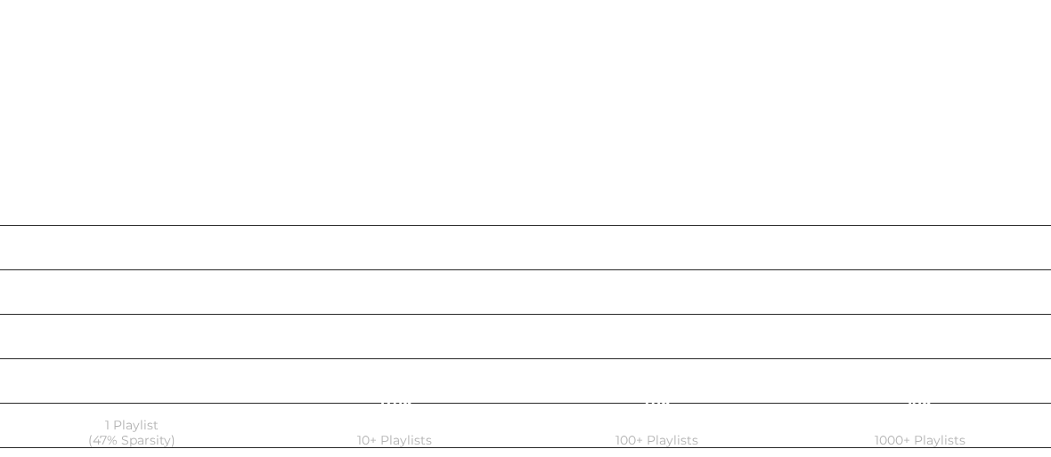

Dataset Overview: The "Long Tail"
1.0M
66.3M
2.26M
66.3
PLAYLISTS
TRACKS
UNIQUE TRACKS
AVG LENGTH
Track Frequency Distribution

Slide 3

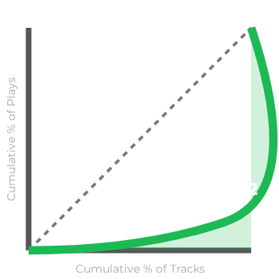
The Challenge: Sparsity & Inequality
Key Insights
Extreme Sparsity: 47% of tracks appear in only 1 playlist. This creates a massive "Cold Start" problem.
Inequality: A Gini Coefficient of 0.921 indicates an extreme popularity bias.
Oligarchy: A tiny fraction of "superstar" songs dominate the dataset.

Slide 4






Phase 1: Data Processing
Pipeline Flow
Infrastructure
Processing 66M+ entries required careful optimization on local hardware.
Hardware: Local processing on M4 MacBook (32GB RAM).
Optimization: Optimized Pandas operations for memory efficiency.
Format: Used Parquet format for fast I/O and compression.

Slide 5

Phase 2: Mining & Clustering
Phase 2A: Association Rules
Phase 2B: Clustering
Algorithm: FP-Growth (Fast Pattern Growth)
Algorithm: K-Means on Track Features
Input: 1M Playlists as Transactions
Input: Playlist Embeddings
Metrics:
Purpose: Group similar playlists together.
•
Support: How many playlists have A & B?
•
Confidence: If A appears, how likely is B?
Result: 5 distinct cluster groups representing playlist "types".
•
Lift: How much more likely than random chance?

Slide 6




Phase 3: Build & Test Four Models
1. Popularity Baseline
2. Co-occurrence Based
Rec: Most-played global songs.
Reasoning: "Wisdom of Crowds". If many like it, you probably will too.
Rec: Using association rules.
Reasoning: Find songs that frequently appear with your tracks (Lift > 2.0).
3. SVD (Collab Filtering)
4. Neural Network (PCA)
Rec: Matrix factorization.
Reasoning: Find playlists mathematically similar to yours and suggest their songs.
Rec: Deep learning on embeddings.
Reasoning: Learn complex non-linear patterns from playlist vectors.

Slide 7


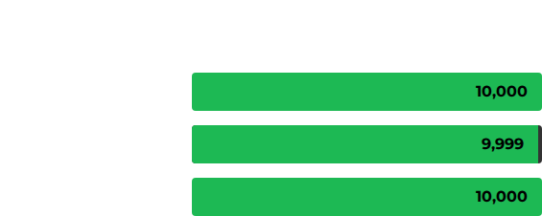
Association Mining Results
We discovered 10,000 high-confidence patterns.
1,282x
AVERAGE LIFT
10,960x
MAX LIFT
Songs with this lift are mathematically inseparable.

Slide 8


The Network Structure
"Superstar" Hubs
The recommendation graph relies heavily on central hubs.
Graph Density: 0.74 (Very High connectivity).
Hub Nodes: A single song can connect to 3.56 Million other paths.
These hubs act as "bridges" between different clusters, crucial for the Popularity model.

Slide 9






Clustering Results: Listener Archetypes
We found 5 Distinct Patterns automatically without genre labels. Users naturally gravitate toward these "styles".
Cluster 0
Cluster 1
Cluster 2
Cluster 3
Cluster 4
Mainstream Fans
Album Listeners
Mixed/Eclectic
Album Listeners
Mainstream Fans
High Artist Pop
High Consistency
No Strong Bias
High Consistency
High Artist Pop
How Clustering Improves Recommendations:
1. Identify which cluster the input playlist belongs to.
2. Only suggest songs from similar playlists (Preserve Context).
3. Tradeoff: Better thematic consistency vs. potential reduction in diversity.

Slide 10
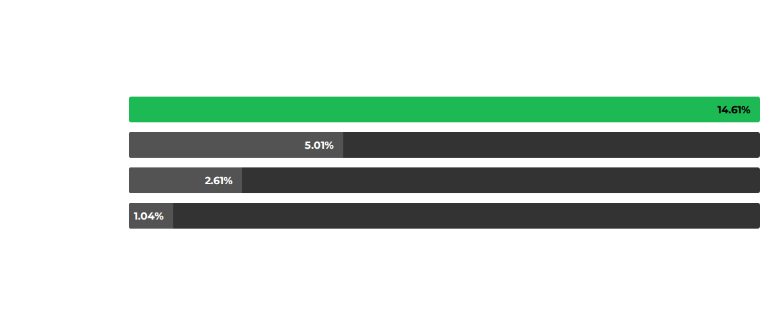
Model Evaluation: Precision@10
Comparison of 4 recommendation approaches. Surprisingly, simplicity wins on sparse data.
Why? The Neural Network overfits on the sparse long tail. The Popularity Baseline leverages the Gini inequality (the "Wisdom of Crowds") to maximize precision.

Slide 11

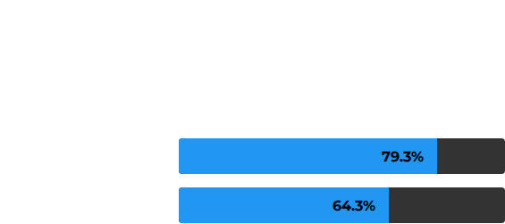

But Precision Isn't Everything
The Diversity Gap
Popularity models have high precision but zero serendipity. Our mining approach excels at discovery.
Discovery Score
Our model recommends across 14+ distinct genres, whereas popularity models restrict users to the "Top 50".

Slide 12
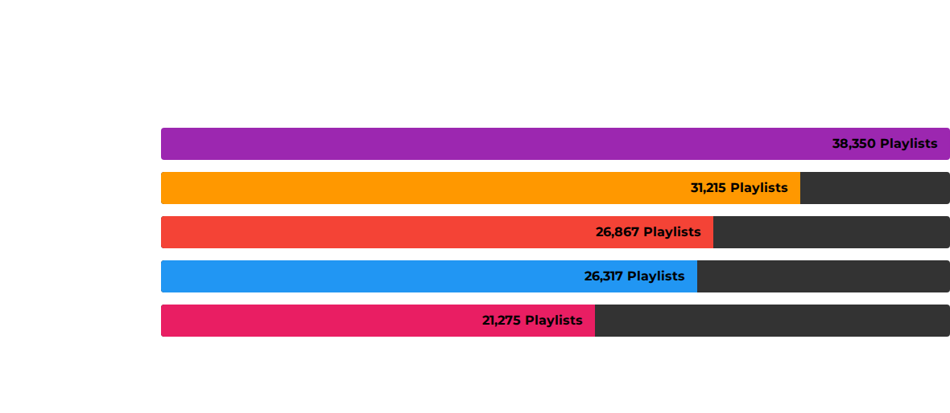
Genre-Wise Performance
Context determines the algorithm. "Chill" and "Party" playlists dominate usage.

Slide 13
Key Findings
Strong Patterns Exist & Are Predictive
Playlists Naturally Cluster
Simple Models Are Hard to Beat
Bottom Line: The co-occurrence patterns + clustering + diversity together create a stronger recommendation system than any single approach alone.

Slide 14

Conclusion & Future Work
Future Directions
Sequential Analysis: Analyzing order (A → B) rather than just co-occurrence.
"Music taste is learnable."
This project proves that even with sparse data, pattern mining combined with clustering can successfully automate playlist continuation, improving user retention and discovery.
Graph Networks: Advanced graph neural networks (GNNs).
Hybrid Ensembles: Weighted average of Popularity (Precision) + Mining (Diversity).

Slide 15

Questions?
Adarsh Singh
github.com/adarsh-singh/spotify-playlist-mining

